Slide 1

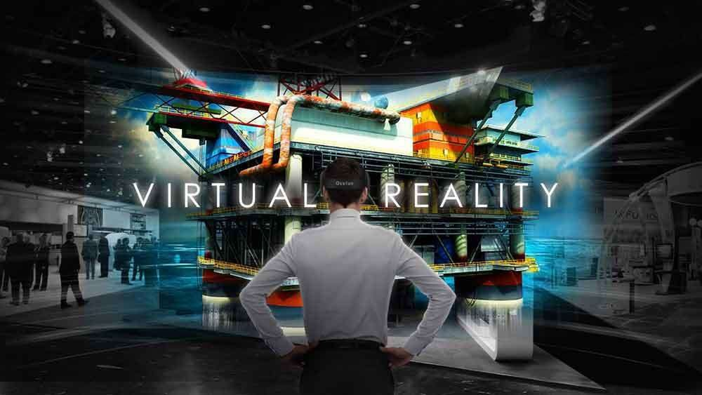
1

Slide 2

FUNDAMENTALS OF COMPUTER GRAPHICS
Computer graphics is an art of drawing pictures on computer screens with the help of programming.
It involves computations, creation, and manipulation of data.
In other words, we can say that computer graphics is a rendering tool for the generation and manipulation of images.

Slide 3
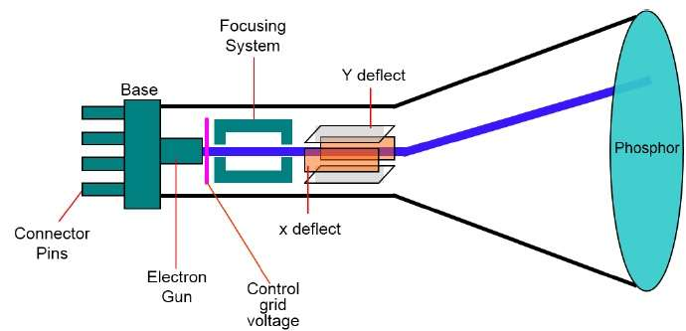
Cathode Ray Tube
The primary output device in a graphical system is the video monitor. The main element of a video monitor is the Cathode Ray Tube CRT

Slide 4
The operation of CRT is very simple −
The electron gun emits a beam of Electrons cathoderays.
The electron beam passes through focusing and deflection systems that direct it towards specified positions on the phosphor-coated screen.
When the beam hits the screen, the phosphor emits a small spot of light at each position contacted by the electron beam.
It redraws the picture by directing the electron beam back over the same screen points quickly.

Slide 5
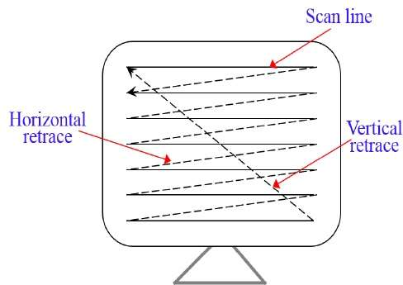
Raster Scan
In a raster scan system, the electron beam is swept across the screen, one row at a time from top to bottom. As the electron beam moves across each row, the beam intensity is turned on and off to create a pattern of illuminated spots.
Picture definition is stored in memory area called the Refresh Buffer or Frame Buffer. This memory area holds the set of intensity values for all the screen points. Stored intensity values are then retrieved from the refresh buffer and “painted” on the screen one row scan line at a time

Slide 6
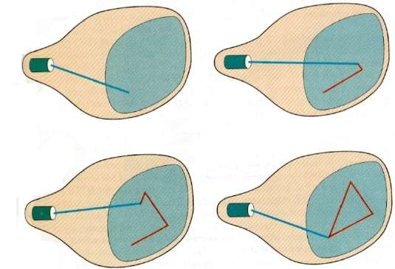
VectorScan
In this technique, the electron beam is directed only to the part of the screen where the picture is to be drawn rather than scanning from left to right and top to bottom as in raster scan. It is also called vector display, stroke-writing display, or calligraphic display.

Slide 7
STEREOSCOPY
Stereoscopy (also called stereoscopics or stereo imaging) is a technique for creating or enhancing the illusion of depth in an image by means of stereopsis for binocular vision.
Any stereoscopic image is called a stereogram.
Most stereoscopic methods present two offset images separately to the left and right eye of the viewer. These two-dimensional images are then combined in the brain to give the perception of 3D depth.
Stereoscopy creates the illusion of three-dimensional depth from given two-dimensional images. Human vision, including the perception of depth, is a complex process, which only begins with the acquisition of visual information taken in through the eyes

Slide 8
One of the functions that occur within the brain as it interprets what the eyes see is assessing the relative distances of objects from the viewer, and the depth dimension of those objects.
The cues that the brain uses to gauge relative distances and depth in a perceived scene include.
Stereopsis
Accommodation of the eye
Overlapping of one object by another
Subtended visual angle of an object of known size
Linear perspective (convergence of parallel edges)
Vertical position (objects closer to the horizon in the scene tend to be perceived as farther away)
Haze or contrast, saturation, and color, greater distance generally being associated with greater haze, desaturation, and a shift toward blue
Change in size of textured pattern detail

Slide 9
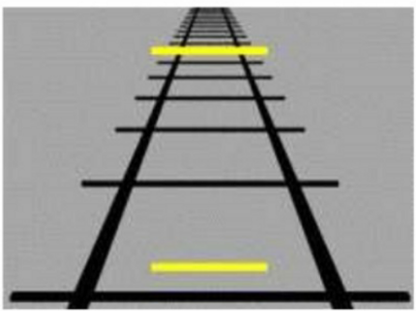
Monocular vs. stereo cues
To distinguish between monocular and stereo cues, we can simply say that:
1- Monocular: single eye
2- Stereo cues: two eyes
, the stereo cues, using both eyes, give you more depth information; but, you can still estimate some depth information from a single photo

Slide 10
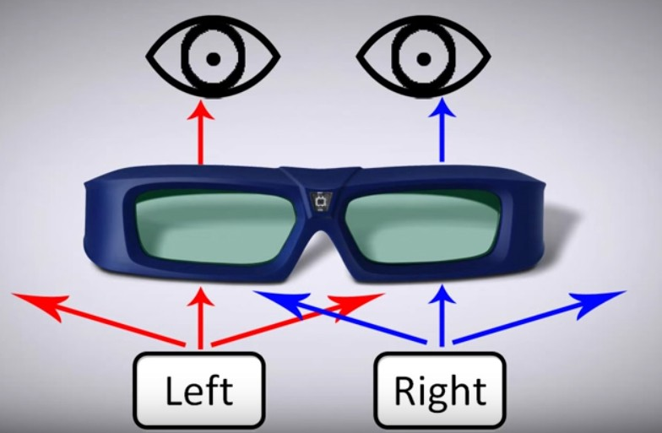
Stereoscopy hardware equipment
The hardware side consists of two main items
screen or the projector.
the glasses.

Slide 11
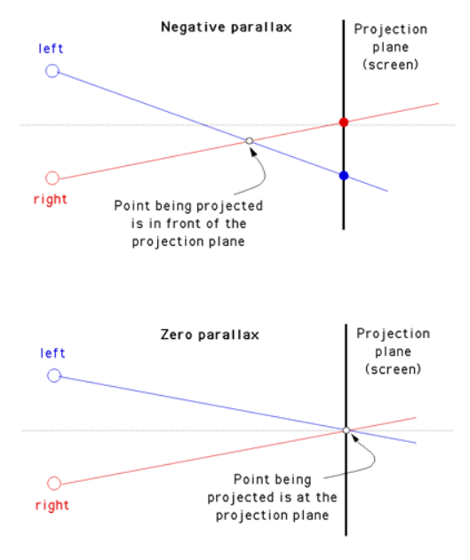
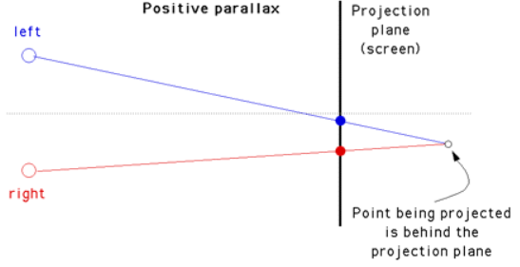
STEREOSCOPIC TECHNOLOGY
Parallax
Parallax is the ability to see an object in two different ways based on the eye distance, That yields to our depth perception. Three types of parallax

Slide 12
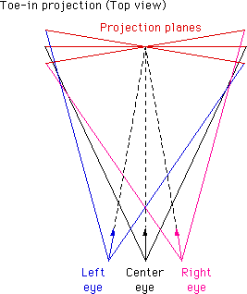
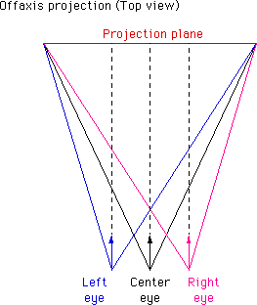
Stereoscopic Viewing
Two styles of view frusta, depending on projection system:
HMDs: can display two independent eye views. The image edges do not have to coincide at zero plane → cross-eye or parallel
Projection/wall/screen systems: represent a “window” into the world.
Seams must be consistent at surface bounds → off-axis

Slide 13
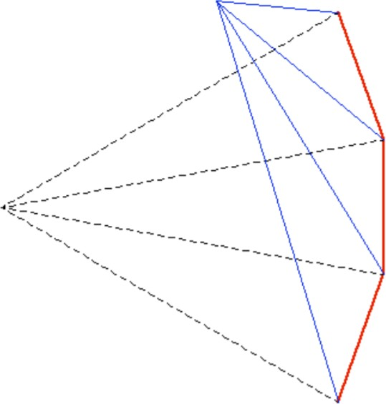
Off-axis Projection: Other Uses
In fixed-display systems, the user moves and takes the center of projection along
The formed view frusta are not symmetrical and therefore, off- axis projections must be individually calculated for each display tile
Actual user
position
Common symmetrical CoP

Slide 14
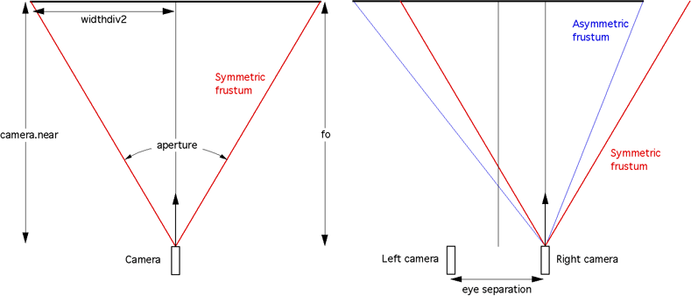
Stereo Rendering Calculations
Right eye
Left eye
𝜃
𝑑 = 𝑎𝑧 𝑡𝑎𝑛
𝑒_{𝑠}
𝑒
0
2
𝑟 = 𝑑 −
2
𝑟 = 𝑑 + ^{𝑠}
𝜃
2
𝑡 = 𝑧₀𝑡𝑎𝑛 ₂
𝑒
𝑒_{𝑠}
𝑙 = −𝑑 +
𝜃
𝑙 = −𝑑 − ^{𝑠}
𝑏 = −𝑧₀𝑡𝑎𝑛 ₂
𝑎: Aspect ratio
𝜃: Vertical aperture
2
2
𝑑
𝑧₀
𝑧₀: (near) depth at zero parallax
𝑒_{𝑠}: Eye separation
𝜃 2
𝜃 2
𝑔𝑙𝑚 ∷ 𝑓𝑟𝑢𝑠𝑡𝑢𝑚(𝑙, 𝑟, 𝑡, 𝑏, 𝑛, 𝑓)

Slide 15
Freeviewing
Freeviewing is viewing a side-by-side image pair without using a viewing device. Two methods are available to freeview:
The parallel viewing method uses an image pair with the left-eye image on the left and the right-eye image on the right. The fused three-dimensional image appears larger and more distant than the two actual images, making it possible to convincingly simulate a life-size scene. The viewer attempts to look through the images with the eyes substantially parallel, as if looking at the actual scene.
The cross-eyed viewing method swaps the left and right eye images so that they will be correctly seen cross-eyed, the left eye viewing the image on the right and vice versa. The fused three-dimensional image appears to be smaller and closer than the actual images, so that large objects and scenes appear miniaturized

Slide 16
Stereo Display Technology
Active stereo: active switching e.g. shutter glasses
Passive stereo: e.g. anaglyph stereo (red/blue), polarized filters, infinitec
Source: [Kau16]

Slide 17
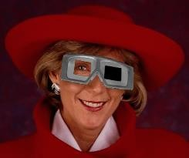
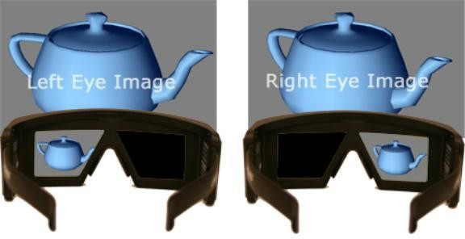
Active Stereo - Shuttering
Shutter glasses use LCD panels to alternate the blocking of light to the left or right eye in sync with the alternating images on the display system
Requires:
high frame-rate display or projector (2Xnormal speed)
Fast display element switching to avoid ghosting artefacts
Very good darkening of the LCD (100% is unattainable)
Source: [Kau16]

Slide 18
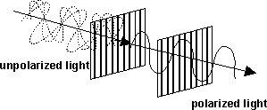
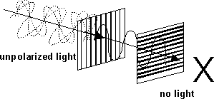
Passive Stereo – Polarization (1)
Use two projectors
Left: vertical filter in front of the lens
Right: horizontal filter in front of the lens
Wear glasses with polarization filters
Left eye: vertical
Right eye: horizontal
Source: [Kau16]

Slide 19
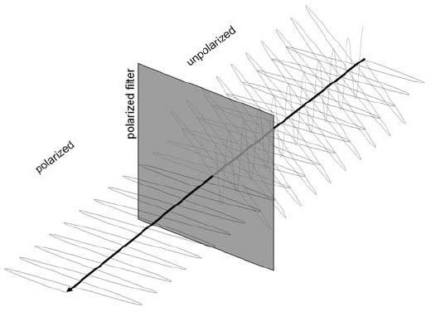
Passive Stereo – Polarization (2)
Source: [Kau16]

Slide 20
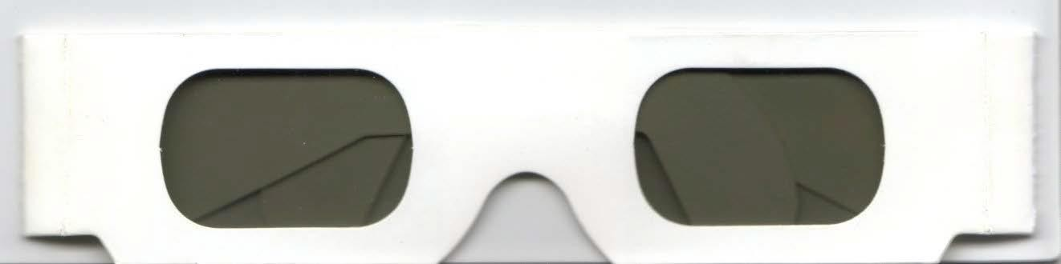
Passive Stereo - Polarized Glasses
Very cheap, paper + plastic foil
Trick: use +/-45°-> no wrong side wearing
Source: [Kau16]

Slide 21
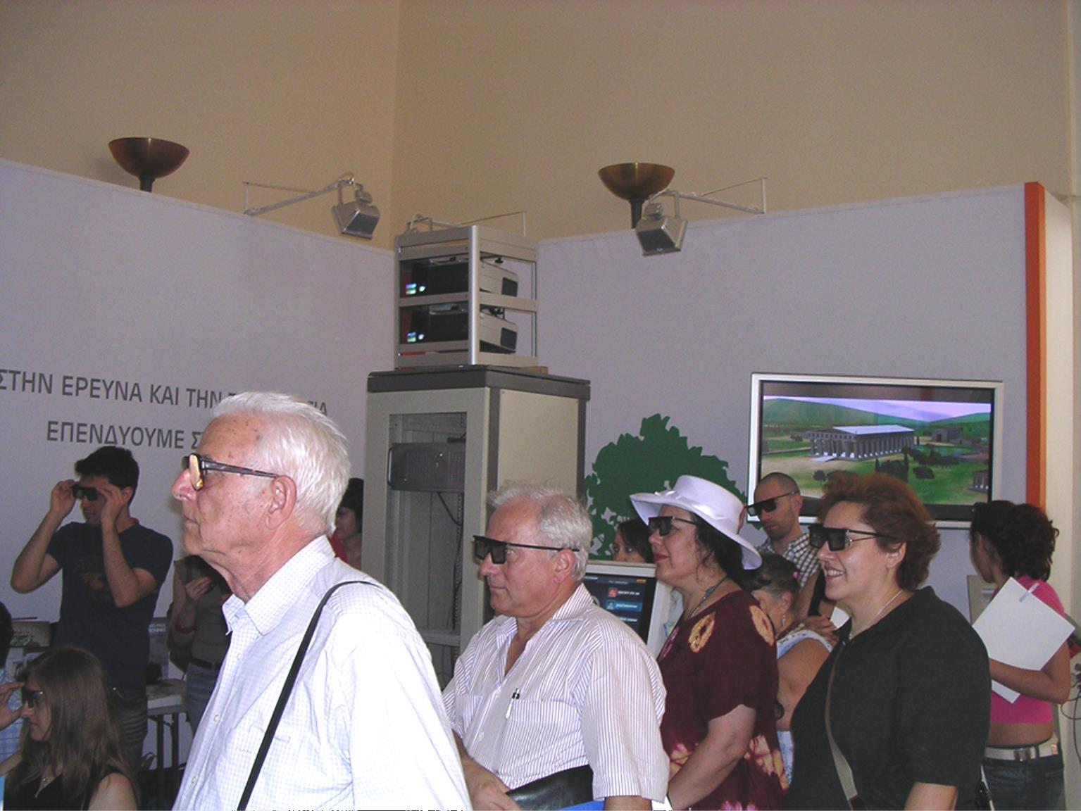
Passive Stereo – INFITEC

Slide 22
Freeviewing
Freeviewing is viewing a side-by-side image pair without using a viewing device. Two methods are available to freeview:
The parallel viewing
method uses an image pair with the left-eye image on the left and the right-eye image on the right. The fused three-dimensional image appears larger and more distant than the two actual images, making it possible to convincingly simulate a life-size scene.
Source: [Kau16]

Slide 23
The cross-eyed
viewing method swaps the left and right eye images so that they will be correctly seen cross-eyed, the left eye viewing the image on the right and vice versa. The fused three-dimensional image appears to be smaller and closer than the actual images, so that large objects and scenes appear miniaturized

Slide 24
Shutter system
A shutter system works by openly presenting the image intended for the left eye while blocking the right eye's view, then presenting the right-eye image while blocking the left eye, and repeating this so rapidly that the interruptions do not interfere with the perceived fusion of the two images into a single 3D image.
It generally uses liquid crystal shutter glasses. Each eye's glass contains a liquid crystal layer which has the property of becoming dark when voltage is applied, being otherwise transparent. The glasses are controlled by a timing signal that allows the glasses to alternately darken over one eye, and then the other, in synchronization with the refresh rate of the screen.

Slide 25
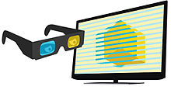
Polarization systems
To present stereoscopic pictures, two images are projected superimposed onto the same screen through polarizing filters or presented on a display with polarized filters. For projection, a silver screen is used so that polarization is preserved. On most passive displays every other row of pixels is polarized for one eye or the other.This method is also known as being interlaced

Slide 26
Interference filter systems
This technique uses specific wavelengths of red, green, and blue for the right eye, and different wavelengths of red, green, and blue for the left eye. Eyeglasses which filter out the very specific wavelengths allow the wearer to see a full color 3D image. It is also known as spectral comb filtering or wavelength multiplex visualization or super-anaglyph.

Slide 27
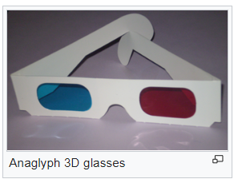
Color anaglyph systems
Anaglyph 3D is the name given to the stereoscopic 3D effect achieved by means of encoding each eye's image using filters of different (usually chromatically opposite) colors, typically red and cyan. Red-cyan filters can be used because our vision processing systems use red and cyan comparisons, as well as blue and yellow, to determine the color and contours of objects.

Slide 28
Holography
Laser holography, in its original "pure" form of the photographic transmission hologram, is the only technology yet created which can reproduce an object or scene with such complete realism that the reproduction is visually indistinguishable from the original, given the original lighting conditions. It creates a light field identical to that which emanated from the original scene, with parallax about all axes and a very wide viewing angle.

Slide 29
Volumetric displays
Volumetric displays use some physical mechanism to display points of light within a volume. Such displays use voxels instead of pixels. Volumetric displays include multiplanar displays, which have multiple display planes stacked up, and rotating panel displays, where a rotating panel sweeps out a volume.

Slide 30
Integral imaging
Integral imaging is a technique for producing 3D displays which are Both autostereoscopic and
multiscopic,
meaning that the 3D image is viewed without the use of special glasses and different aspects are seen when it is viewed from positions that differ either horizontally or vertically.
This is achieved by using an array of microlenses

Slide 31
SOFTWARE FOR STEREOSCOPY
Bino
Bino plays stereoscopic videos, also known as 3D videos.
KMovisto (Version 0.6.1)
KMovisto is a molecule viewer for using in quantum chemistry. You are able to import GAUSSIAN 94 and GAUSSIAN 98 files (obtained from UNIX or MS Windows systems) or XYZ files and view your results in several view modes or edit the molecule geometry. Especially the 3D view modes (anaglyph or stereo pair) make it possible to enjoy stereoscopic impressions of the molecular structure - so this is what KMovisto makes a real 3D molecule viewer

Slide 32
Mplayer
It is a command line video player but is possibly the most popular on Linux because of its capacity to play almost any anything, especially if you count GUIs that use it as a base such as gnome-mplayer and smplayer.
Plascoin
Plascolin is a Linux X11 tool to create and to view anaglyph stereo images or to display the left and right image on separate output devices (e.g. projectors).
SIV
SIV (Stereoscopic Image Viewer) is capable of displaying JPS stereo images and MPO stereo images in different stereo modes. It was tried in fullscreen/windowed mode with anaglyphic and quad buffered stereo mode.Main features in the 1.0 version are quad buffered stereo and vr920 headtracking.

Slide 33
Split MPO
This script takes a folder of .MPO files, extracts left and right images, and assembles them into pairs suitable for cross-eye, side-by-side and over-under (View Magic) use.
The script seems to run fine on Linux and Mac. The shell is specified as "bash", but most should work as well. The script output files are easy to size in Open Office Draw. This script and Open Office Draw are a simple solution for anyone with a Mac or Linux to enjoy stereo photos from this fine Fuji camera.
Fuji W3 3D QuickLook Plugin (Version 1.0.0)
This QuickLook plugin enables a Fuji W3 3D MPO format image to be viewed by default in the finder and other applications using QuickLook on Mac OSX 10.5 or later. QuickLook isn't available for systems below 10.5
StereoPress (Version 1.4.0-E)

Slide 34
3D Slide Projector (Version 1.05)
This software for creating your 3D slide show runs on Windows computers. It can make 3D images for anaglyphs or for interleave images or for dual projectors from your Left & Right stereo images taken by your digital cameras or scanner, and it can sync wav sounds. All order of your slides show and sounds are indicated by 'order.txt' file at the same folder of this software.
If you have two PC-projectors and dual VGA video card, you will be able to have 3D projection by using dual screen mode of this program.
Anaglyph Maker (Version 1.08)
A wonderful free program to make black & white as well as color anaglyphs and interlaced images for LC-shutter glasses. Requires Windows™ 95, 98, 2000, Me, NT or XP.
Stereo Movie Builder (Version 0.3)
A software for building (stereoscopic) videos from a set of still pictures with various effects as zoom, pan and transitions. StereoMovieBuilder can generate standard AVI files, WMV files or Quicktime movie files. Input images can be in the JPEG or PNG format and videos. Input images can be monoscopic or stereoscopic (side by side images).

